Slide 1
Sentiment analysis
CAPSTONE PROJECT
Presented By:
Pedhapudi Shakthi Vamsi
College Name: Aditya College of Engineering
Department: Computer Science and Engineering
Internship domain: Artificial intelligence and Machine learning
SkillsBuild E-mail id: s27266022@gmail.com

Slide 2
OUTLINE
Problem Statement (Should not include solution)
Proposed System/Solution
System Development Approach (Technology Used)
Algorithm & Deployment
Result
Conclusion
Future Scope
References

Slide 3
Problem Statement
Example: Restaurants face a significant challenge in manually sifting through vast amounts of online reviews to extract meaningful insights. This manual process is not only time-consuming but also prone to human error and subjectivity. There is a need for an automated solution that can efficiently analyze these reviews and categorize them into sentiments (positive, negative, or neutral). Such a solution would allow restaurant managers to quickly and accurately gauge customer satisfaction levels and address issues proactively.

Slide 4
Proposed Solution
The proposed system aims to address the challenge of different food reviews that are given by the customers so the goal is to design and implement a machine learning-based sentiment analysis system that can analyze textual data from food reviews.
Data Collection:
Gather a dataset of food reviews from online platforms, containing the review text and rating.
We can collect this data from Google reviews and also directly from restaurant websites.
Data Preprocessing:
Clean and preprocess the collected data to handle missing values, outliers, and inconsistencies.
In this text preprocessing there are mainly these steps – Tokenization, stemming, lemmatization, lowercase and stopwords.
Machine Learning Algorithm:
Implement a machine learning algorithm, here we use the Naive Bayes algorithm.
In this algorithm we mainly use some of the libraries-pandas, sklearn, nltk and seaborn.
Deployment:
Develop a user-friendly interface for restaurant managers to input reviews and get sentiment analysis results.
Choose the best-performing model from your experiments, ensuring it balances accuracy, speed, and interpretability.
Evaluation:
Fine-tune the model based on feedback and continuous monitoring of prediction accuracy.
Here we classify the reviews on restaurants using some data cleaning and text-preprocessing methods
Result:

Slide 5
System Approach
The system approach for sentiment analysis on restaurants involves leveraging natural language processing (NLP) and machine learning techniques to automatically evaluate and categorize customer reviews. This process starts with data collection from various sources such as review websites and social media platforms.
The text data is then preprocessed to remove noise and irrelevant information. Feature extraction methods, such as plotting, tokenization and lemmatization, transform the text into a structured format suitable for analysis. Sentiment classification algorithms, typically trained on labelled datasets, are applied to identify and categorize the sentiment expressed in the reviews as positive, negative, or neutral.

Slide 6
System Requirements:
Product name: HP Laptop 15s-gr0xxx
OS : Windows 11 Home
BIOS: F31-06/16/2022
Keyboard revision: v38.25
Total memory: 8GB
Processor name: AMD Ryzen 3 3250U with Radeon Graphics
Libraries used :
To build these models we require libraries like nltk, sklearn,
pandas, matplotlib, WordCloud and seaborn.

Slide 7
Algorithm & Deployment
In the Algorithm section, describe the machine learning algorithm chosen for food reviews to Improve Customer Satisfaction
Algorithm Selection :
Provide a brief overview of the chosen algorithm (Naïve Bayes algorithm) and justify its selection based on the problem statement and data characteristics.
The Naive Bayes algorithm can be highly useful for sentiment analysis of food reviews due to its simplicity, efficiency, and effectiveness in text classification tasks.
Data Input :
Use techniques such as TF-IDF (Term Frequency-Inverse Document Frequency) or bag-of-words to convert textual data into numerical features that can be fed into the Naive Bayes classifier.
Training Process :
Model Selection: Use the Multinomial Naive Bayes classifier, which is well-suited for text data
Training: Fit the Naive Bayes model on the training data.
Prediction Process :
Using Naive Bayes for sentiment analysis of food reviews is advantageous due to its simplicity, efficiency, and effectiveness with text data.
It can quickly provide valuable insights into customer sentiments helping restaurants to improve their services and enhance customer satisfaction.

Slide 8
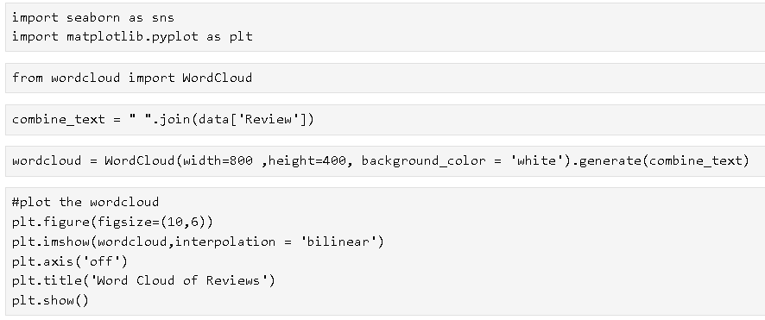
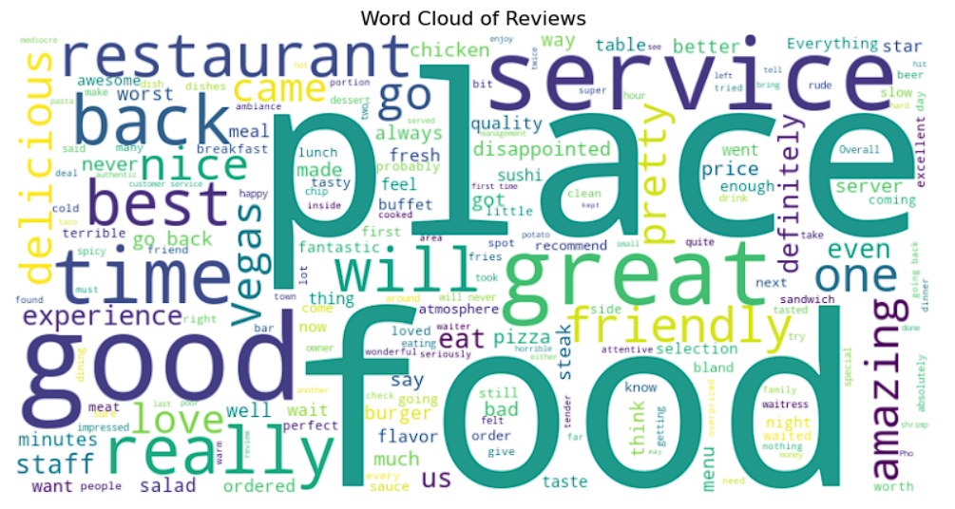
Code snippet of wordcloud:

Slide 9
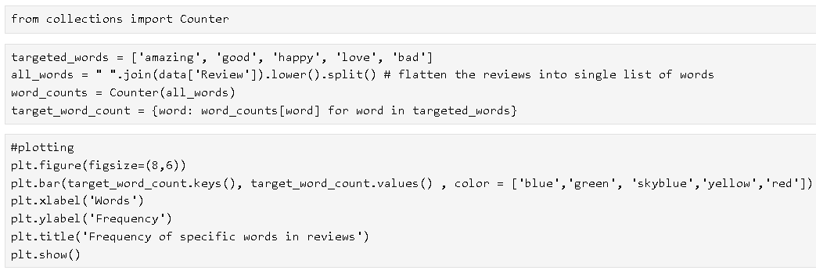
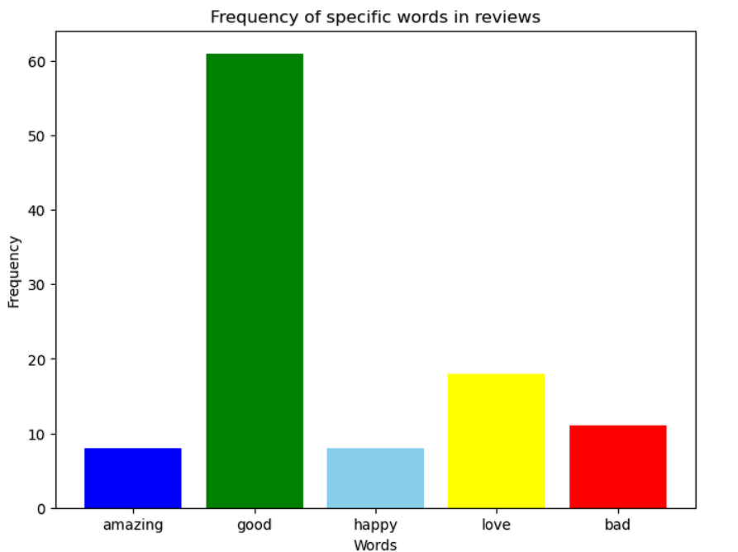
Code snippet of bar plot:

Slide 10
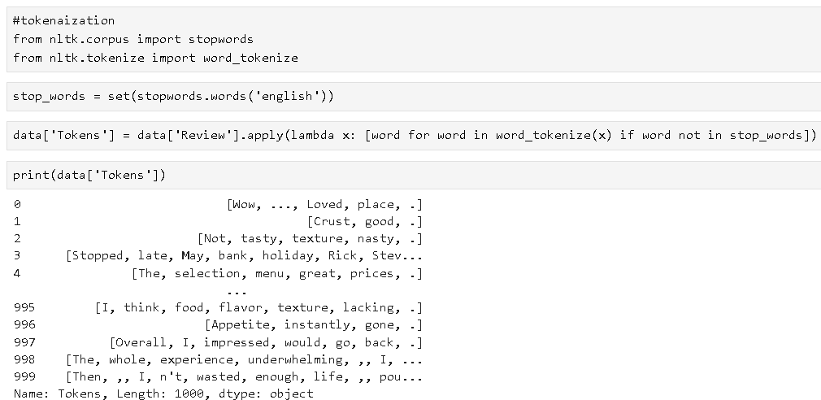
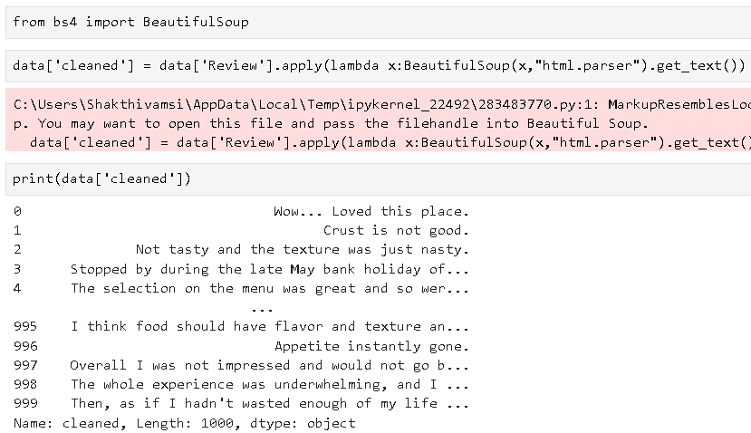
tokenization:
Removing html tags from reviews:

Slide 11
Result
Given the text of a food review, a sentiment analysis model will process the text and output one of the sentiment categories
Positive review:
Review Text: "The food was amazing! The pasta was perfectly cooked and the sauce was rich and flavorful. Highly recommend this restaurant!“
Sentiment: Positive
Negative review:
Review Text: "I had a terrible experience. The service was slow, and the food was cold and bland. I won't be coming back.“
Sentiment: Negative
Neutral review:
Review Text: "The food was okay, nothing special. The ambience was nice, but I've had better dining experiences elsewhere.“
Sentiment: Neutral

Slide 12
Conclusion
From the above study, an attempt has been made to classify sentiment analysis for restaurant reviews using machine learning techniques. Two algorithms namely Multinomial Naive Bayes and Bernoulli Naive Bayes are implemented.
Evaluation metrics used here are accuracy, precision and recall.
Using Multinomial Naive Bayes:
The accuracy of prediction is 77.67%.
The precision of prediction is 0.78.
Recall of prediction is 0.77.
Using Bernoulli Naive Bayes:
The accuracy of prediction is 77.0%.
The precision of prediction is 0.76.
Recall of prediction is 0.78.

Slide 13
Future scope
Discuss potential enhancements and expansions for the system. This could include incorporating additional data sources, optimizing the algorithm for better performance, and expanding the system to cover multiple cities or regions. Consider the integration of emerging technologies such as edge computing or advanced machine learning techniques.
Real-Time Feedback Mechanism: Implement real-time feedback systems to capture and analyze customer sentiments instantly, enabling immediate service improvements.
Predictive Analytics: Develop predictive models using historicel sentiment data to anticipate patient needs and optimize resource allocation and service planning.
performance and identify best practices for continuous Improvement.

Slide 14
References
Customer Reviews: Data can be sourced from platforms like Yelp, TripAdvisor, and Google Reviews.
API Integrations: Use APIs from platforms like Twitter and Google Map reviews to collect real-time sentiment data.
NLP Libraries: Utilize tools such as NLTK and TextBlob for text processing and sentiment analysis.
Here to gather all the reviews of a restaurant we can use the BeautifulSoup library and also by importing csv library
which we can save all the data set into a .csv file format.
Then we can use all the Naïve Bayes algorithm techniques on the data set which was
already saved in Jupyter Notebook in .csv format with help of the BeautifulSoup and csv library

Slide 15
THANK YOU

